Slide 1



Growth Analysis Report
View in Power BI
Last data refresh:
15/07/2024 17:02:29 UTC
Downloaded at:
20/07/2024 14:59:26 UTC

Slide 2
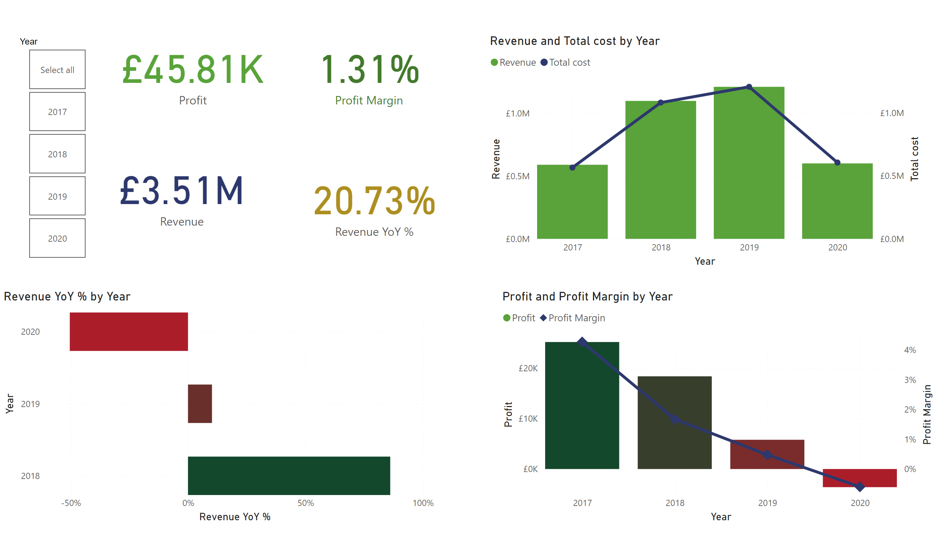
KPI
Notes:
barChart
No alt text provided
lineStackedColumnComboChart
No alt text provided
lineStackedColumnComboChart
No alt text provided
card
No alt text provided
card
No alt text provided
slicer
No alt text provided
card
No alt text provided
card
No alt text provided

Slide 3
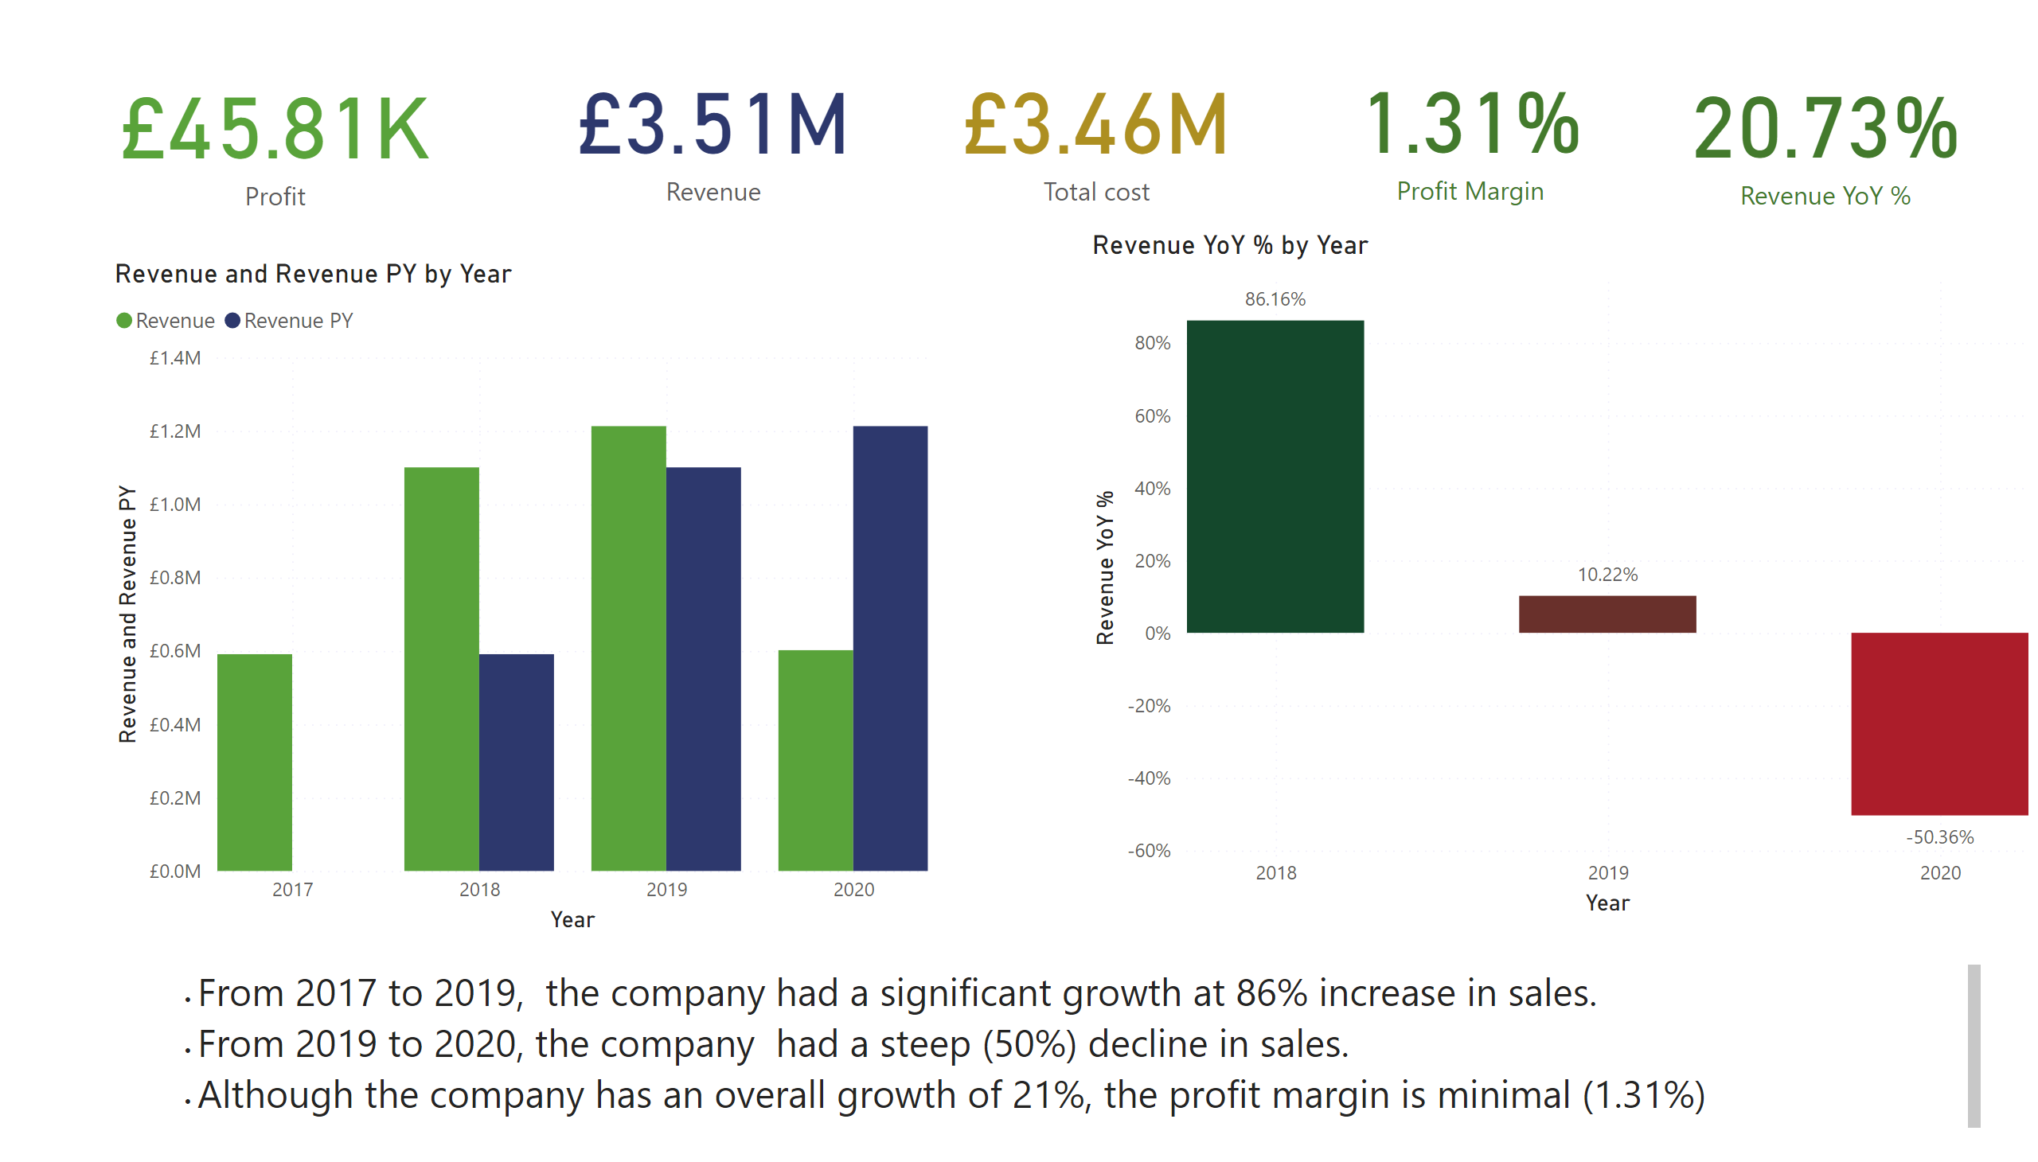
Executive Summary
Notes:
card
No alt text provided
card
No alt text provided
card
No alt text provided
card
No alt text provided
card
No alt text provided
clusteredColumnChart
No alt text provided
columnChart
No alt text provided
textbox
No alt text provided

